Slide 1

HEALTH TECH
ICON
By
SARUMATHI G
CHAANDHA RAGHAV C
RANJITH V
NAFISA MUKHTAR M
BANNARI AMMAN INSTITUTE OF TECHNOLOGY,SATHYAMANGALAM

Slide 2
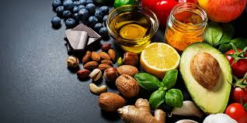
What role does diet play in health?
Good nutrition is an important part
of commencing a healthy lifestyle.
Maintaining Bone Strength
Preventing and Management of
Diseases.
HEALTHY DIET LEADS TO A
WEALTHY LIFE.

Slide 3
Recommendation
Users meal and recipe recommendation.
We have proposed a recipe recommendation method that is based on the user's preferences via a recording survey.
After getting the user’s recipe preferences ,we use his/her recipe cooking history and know their needs what they want.

Slide 4
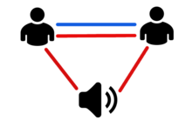
User’s Interest
Proposed Solution…..
Scoring method of recipes based on the users food preferences.
Quantity of ingredient in a recipe.

Slide 5
How do other people influence you?
Peer recommendations can help people become aware of various other new sources.
You may get inspired from other people’s recommendation on healthy meal recipes and devise more novel ways.
We propose a method for automatically generating recipe data, which we plan to add to our system.

Slide 6


Connect and Engage
Don’t stop with tasting our delicious dishes
Connect with other users and try improving the recipe
Discover the unheard cuisines

Slide 7
How
will this
Help
people?
Personalized diet recommendations
Buy necessary goods with a single tap
Keep track of the calorie intake
Leave your nutritious dishes for others to try

Slide 8
Instant Assistance Of Doctors
No need for panicking in tense situations, we got you covered
24 hours a day, 7 days a week
Connect with the verified doctors around the world
Consult with a doctor, Get timely checkups and to ensure correct diagnosis

Slide 9
Get your queries answered
Why would you rush a decision regarding your health?
Take detailed answers from the doctors
Connect with the doctors through chat or a phone call
Regular consultations regarding medication period
Promoting steady diagnosis
Get detailed answers from the doctors themselves

Slide 10
User Preferences
We don’t compromise your preferences
Connect with your friends
Take voice notes from the doctor
Make an gallery of your purchases, prescriptions and diets
Share the contents of the gallery in any way you want
We bring you More features for a lower resource level

Slide 11
Select what you want!
Snacks
Meals
39
4
29
27
11
9
20
35
5
Choose from the wide collection of things we have
See what people prefer around the world
18
18
15
China
US
Europe
India
Popularity based on location

Slide 12
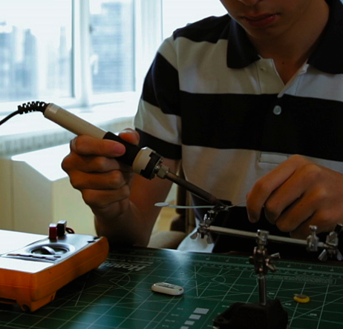
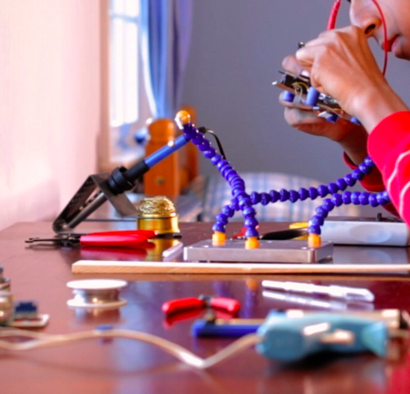

Instant Medication
1.Prescriptions can be uploaded in the website.
2.Connect with pharmacies nearby.
3.Pharmacies will send notification to the user based on availability of stock.
4.Pay the bill, receive medicines instantly.

Slide 13
Advantages of this aspect
Get medicines instantly
Reduce people's commutation to pharmacies.
Helps users stay safe at home and keeps us away from going out.
Availability of stock can be monitored without the person physically going to the pharmacy.

Slide 14
Importance of taking medicines on time
Taking medicines on time will make the patients recover sooner.
It ensures best possible results for the treatment.
Helps patients get rid off their illness.
Medicines also have direct impacts on disease symptoms. When symptoms get cured, the patient feels refreshed and energised.

Slide 15
Medicine reminder
The users can also add reminders for their medicines.
The date time and name of the user needs to be provided by the user following which alarm reminders will be initialised based on user inputs.
This will help users ensure they take medicines on time without fail.

Slide 16
Chat With Me (Virtual Assistant )
Feeling alone or bored makes people feel depressed and sad.
How about a virtual assistant that chats with people and diagnoses their diseases?
It will also analyse the current mindset of the user with the statements that the user provides during the chat.
The assistant will provide them information so as to bring them out of such a condition.

Slide 17

Fight off Depression!
Depression is state of low mood and aversion to activity.
Based on this sentiment analysis users with depression can be easily identified
Proper and early counselling will thus help them fight off depression.
Further the people in close contact with these users will be informed so that they recover sooner.

Slide 18


Slide 19
Conclusion!!!
In a nutshell, our application Medlyf helps people remain independent, safe and healthy.
IT IS HEALTH THAT IS REAL WEALTH NOT PIECES OF GOLD OR SILVER.

Slide 20


